Slide 1
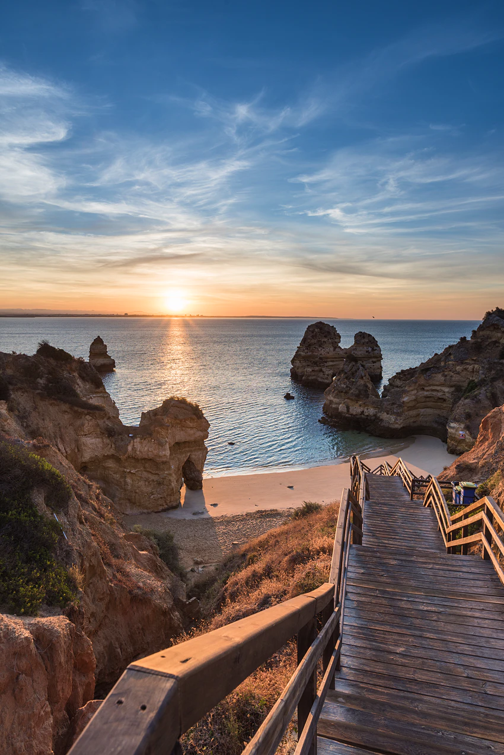
Portuguese culture and language
Agnese Fridenberga
2023

Slide 2
Table of contents
01.
Portugal
02.
Architecture
03.
04.
National holidays
Food
06.
Art
Literature
07.
05.
Music
08.
Sports
09.
Portuguese language
10.
Phrases

Slide 3
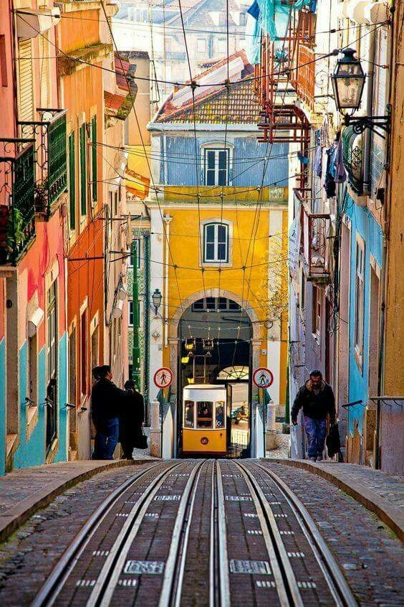
01.
PORTUGAL

Slide 4
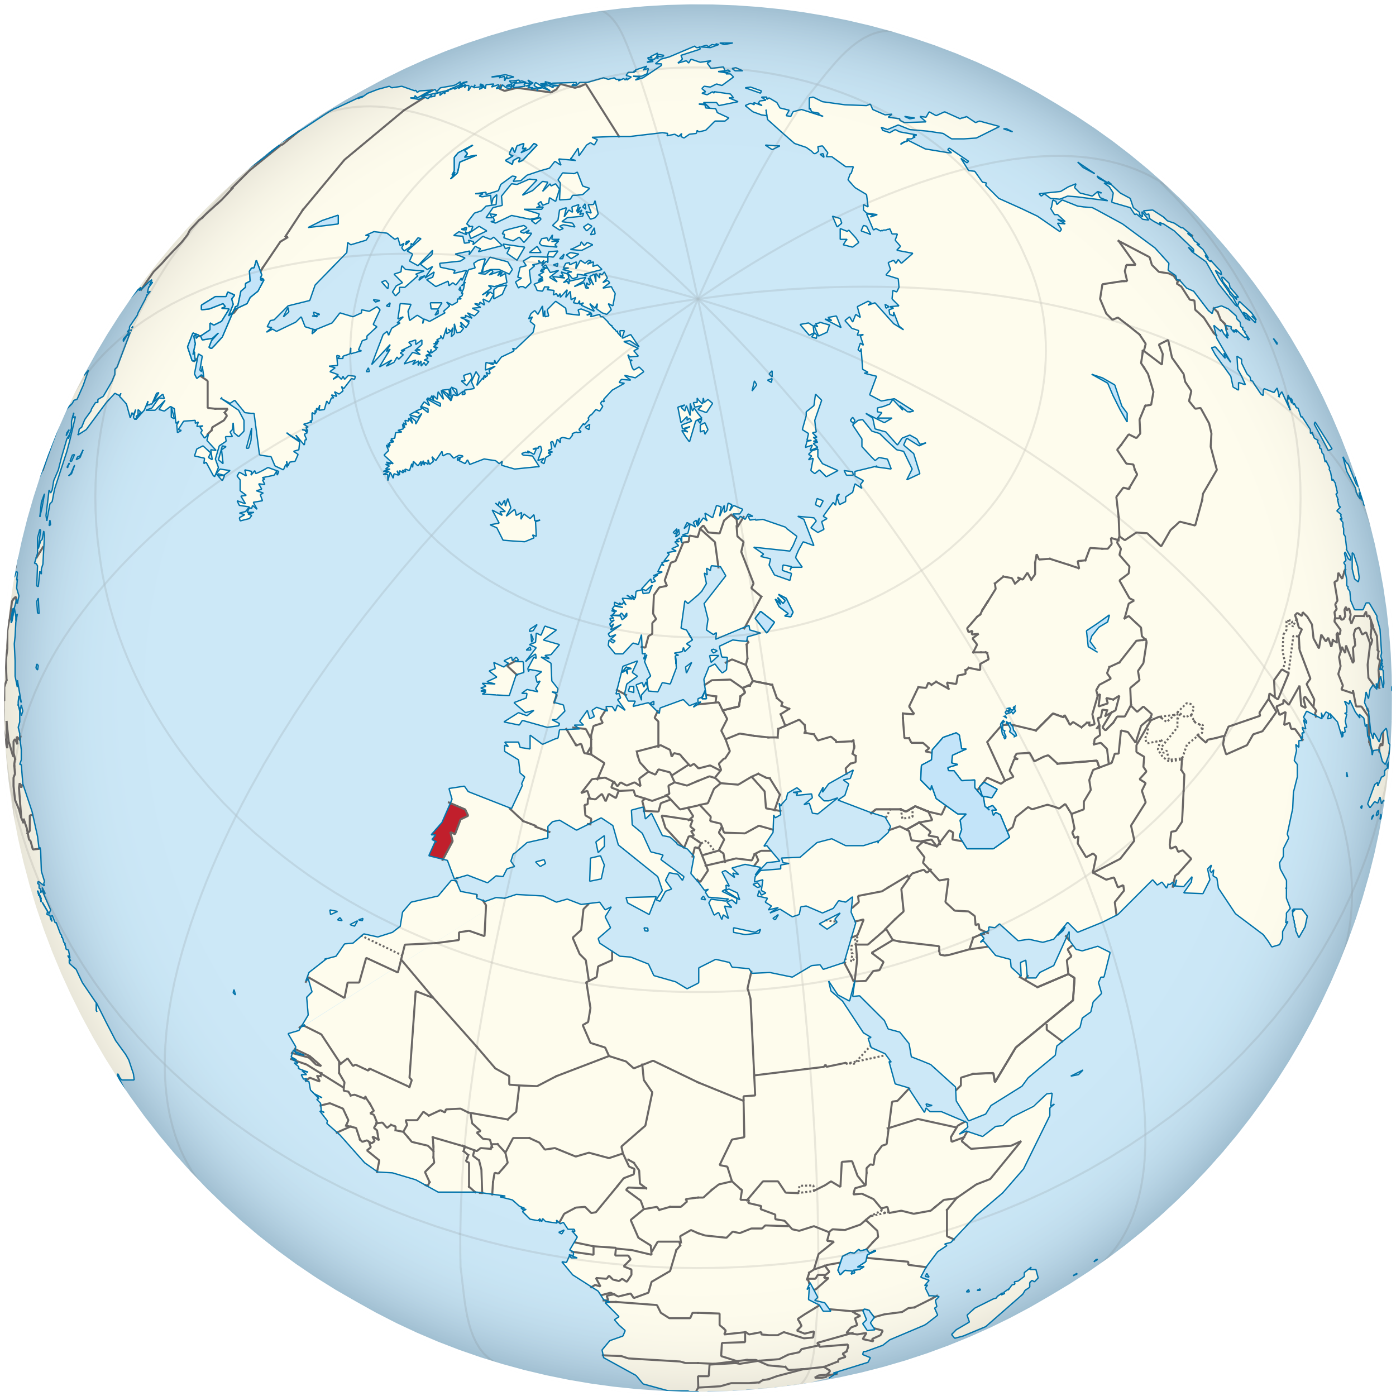
Portugal
Southwestern Europe, next to Spain.
Lisbon is the capital.
Official language is Portuguese.
Population is over 10 million.

Slide 5
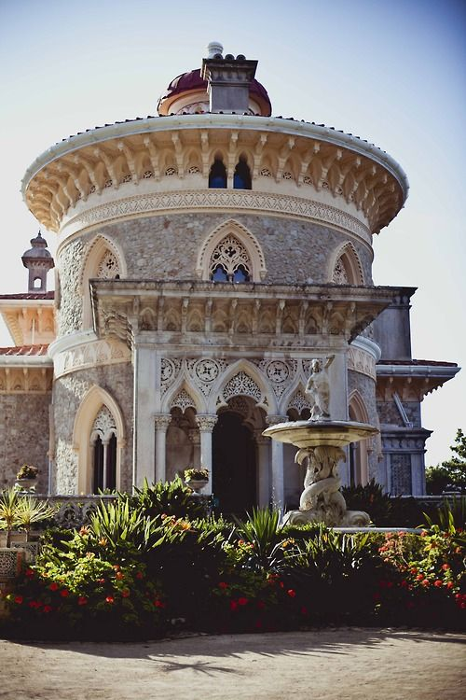
02.
ARCHITECURE

Slide 6
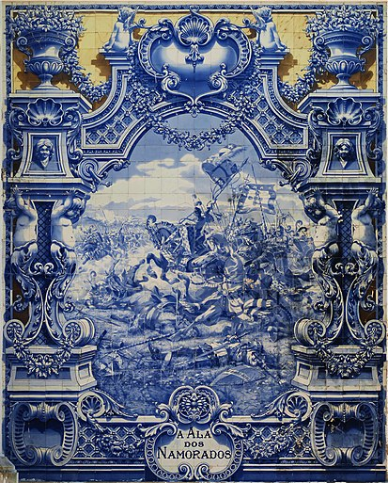
Modern Portuguese architecture follows the most advanced trends seen in European mainstream architecture.

Slide 7
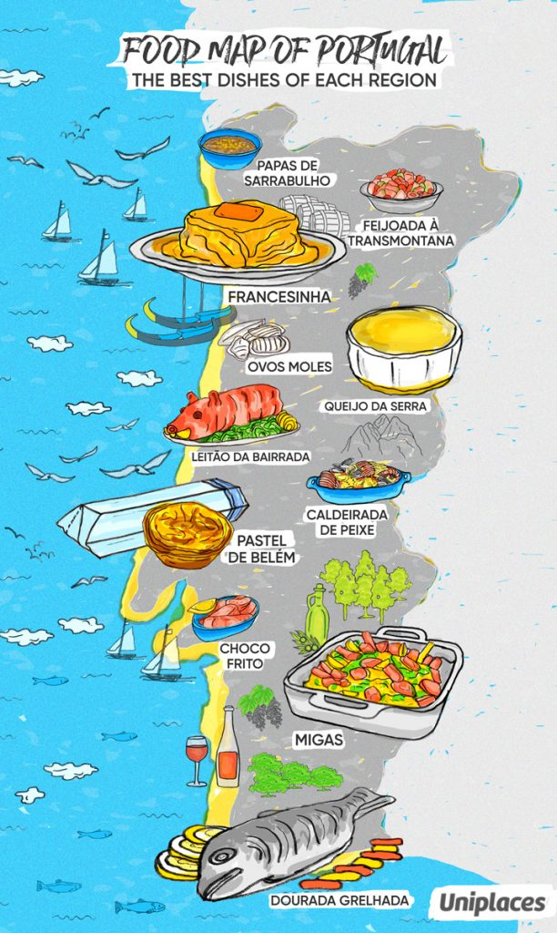
03.
FOOD

Slide 8
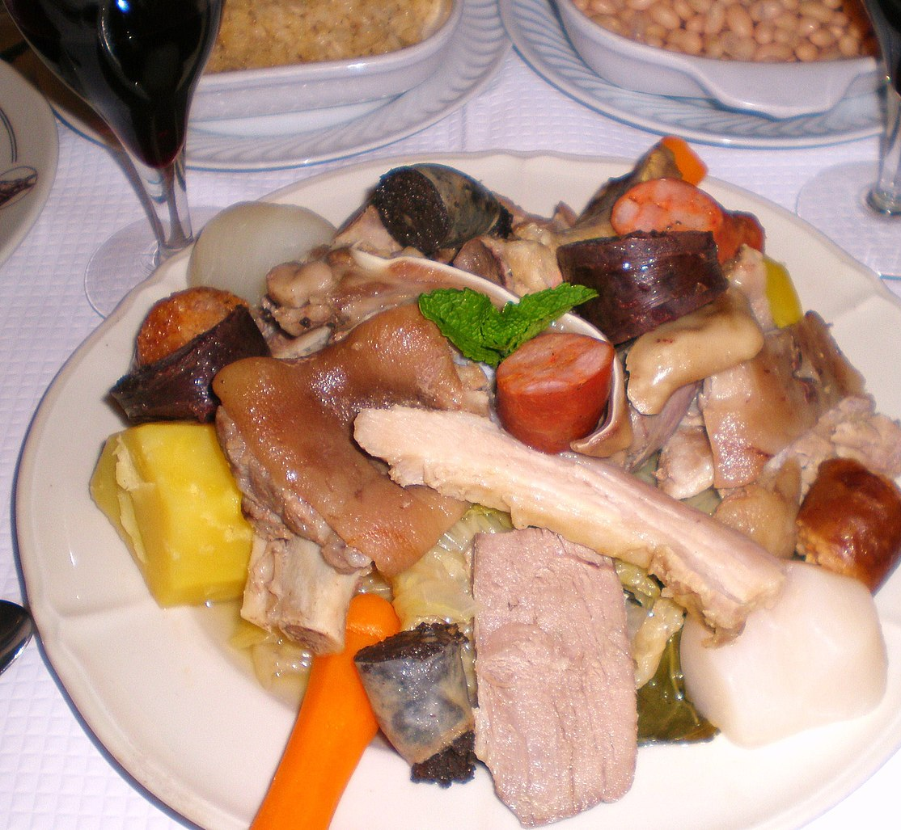
Each region of Portugal has its own traditional dishes.

Slide 9
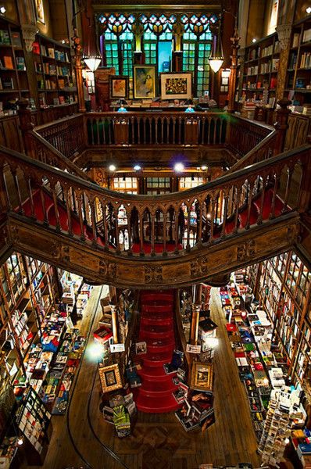
04.
LITERATURE

Slide 10
Portuguese literature has developed since the 12th century from the lyrical works of João Soares de Paiva, Paio Soares de Taveirós and King Denis of Portugal.

Slide 11
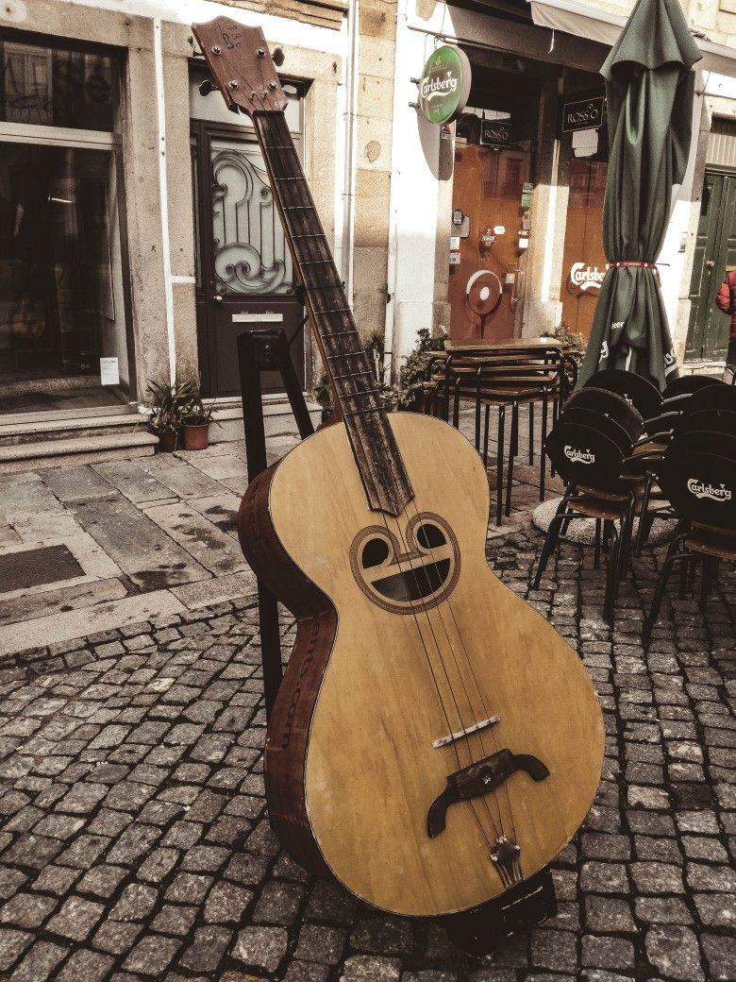
05.
MUSIC

Slide 12
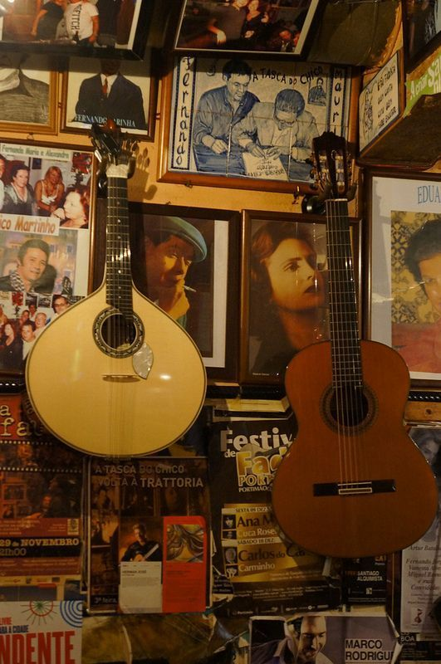
Portuguese folk music are traditional songs that tell through a poetic character their beliefs and their history to other people.

Slide 13
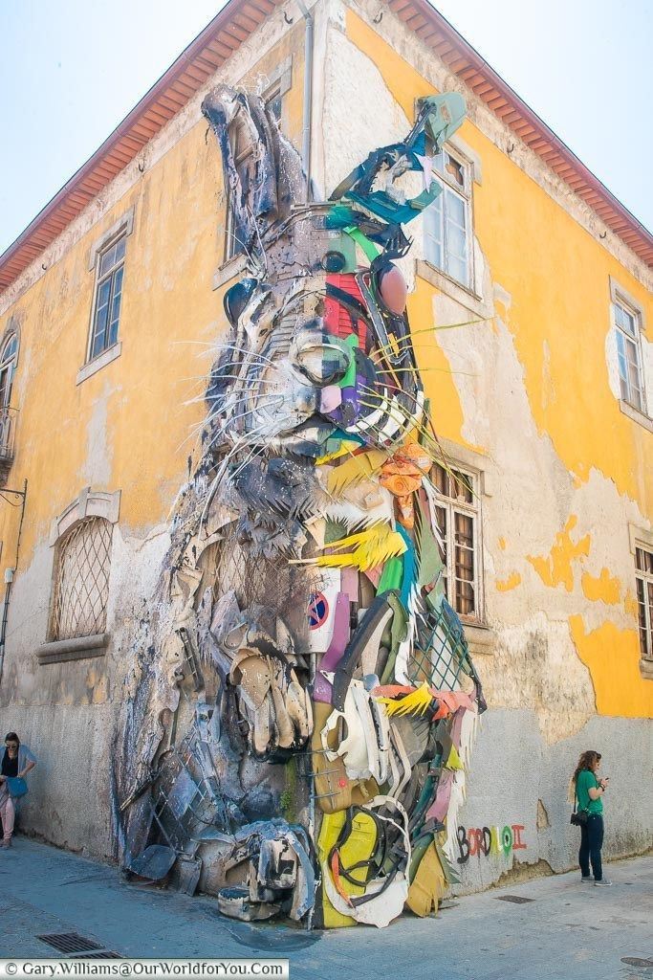
06.
ART

Slide 14
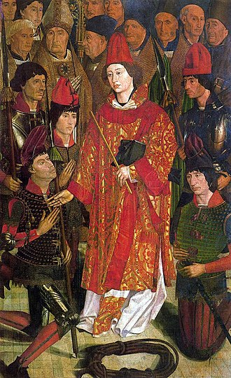
Portuguese art was very restricted in the early years of nationality, during the reconquista, to a few paintings in churches, convents and palaces.

Slide 15
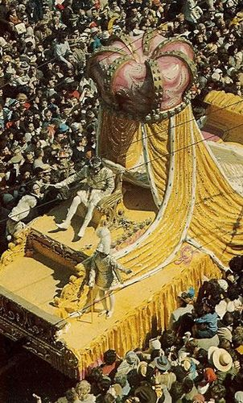
NATIONAL HOLIDAYS
07.

Slide 16
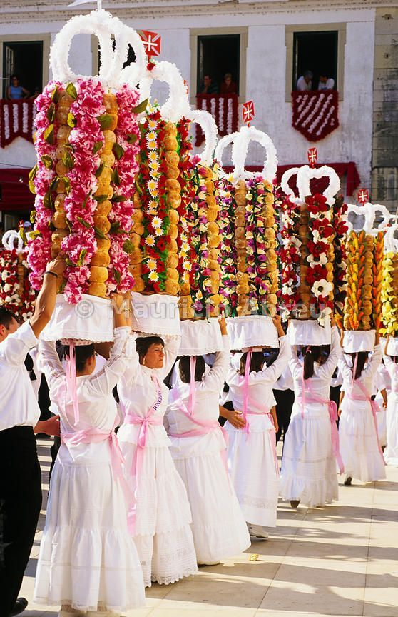
Carneval, marks the first day of a period of 40 days before Easter, also known as Entrudo.
Portugal day is June 10th.
All Saints' Day is November 1st .

Slide 17
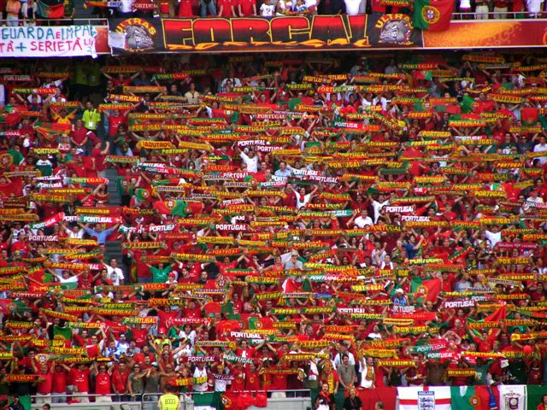
SPORTS
08.

Slide 18
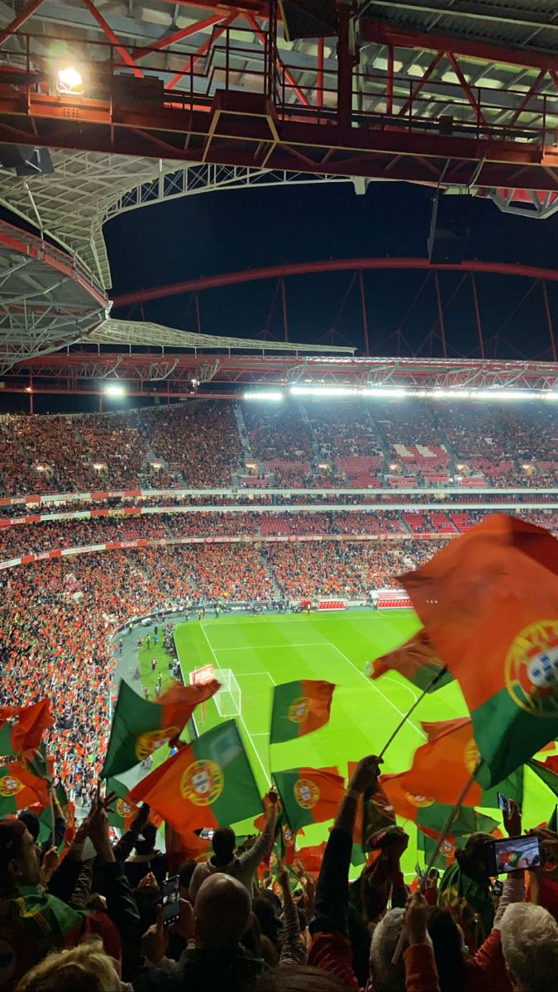
Football is the most popular sport in Portugal.

Slide 19
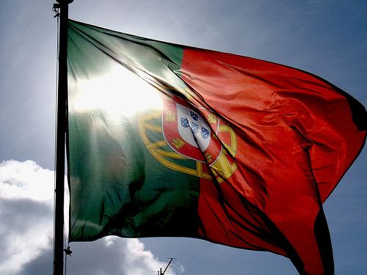
09.
PORTUGUESE LANGUAGE

Slide 20
Portuguese is a western Romance language. It is an official language in 7 countries.

Slide 21
09.
PHRASES

Slide 22
Hello – Olá
How are you? – Como está?
Nice to meet you – Prazer
Goodbye – Adeus
Excuse me – Com licença
Please – Por favor
Thank you - Obrigada/o
Yes/No – Sim/Náo

Slide 23
Where is …? – Onde está …?
What’s your name? - Qual o seu nome?
I don’t understand – Eu nao entendo
Do you speak English? – Fala ingles?

Slide 24
References
Pinterest
Google tulkotājs
Culture of Portugal – Wikipedia
15 basic Portuguese language phrases to know before your trip to Portugal (trafalgar.com)
Portuguese language – Wikipedia
Portugal - Wikipedia

Slide 25
Thank you for your time!

